Slide 1
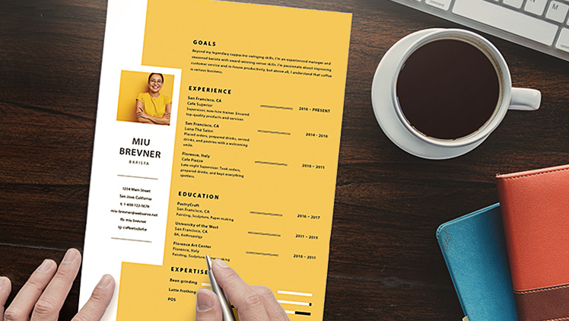
Resume Preparation- Tips and Tricks “Open the door to opportunity!”

Slide 2

What is a Resume?
It highlights your objectives and achievements
It’s a summary of your work experience and educational qualification details
It highlights your skills relevant to the field.
It highlights your extracurricular and leadership qualities.

Slide 3

Resume should include:
Heading (Your name & contact details)
Objective (Customize as per the job you are applying)
Work Experience ( current to previous and should be followed soon after your objective)
Education Qualifications (current to previous)
Awards/Achievements/certifications
Skills
Language proficiency

Slide 4

1. Heading:
Name
Address (current address)
Email (active)
Phone Number (active)
2. Objective:
It should be related to the job you are applying for and states what kind of career you are looking for in your future along with the skills that make you suitable for that role.
3. Work Experience(Start from current to previous):
4. Educational Qualifications (Start from current to previous):
Degree/Certificate | Institution | Year of Passing | Board/University | Marks (%) or GPA

Slide 5

5. Awards/Achievements:
Mention about your key Awards won in school or college.
Any scholarships with short descriptions
6. Skills:
Certifications completed
Foreign Languages
Any other skills or certification undergoing
7. References:
Add relevant references names , designation, contact details.

Slide 6
Key Points to note..
Review a successful examples
Use a template
Choose a basic font (Easy to read)
Avoid using ‘I’
Should not exceed 2 pages
Put the most important and relevant accomplishments first
Follow bulleting points
Send resume properly with the correct attachments as per the employer requirements

Slide 7

Good Signs of a resume
Accurate Details
Relevant Details
Avoid Abbreviations
Check Grammar
Pitfalls
Too long
Grammatical mistakes
Hard to read to understand
Irrelevant and inaccurate details

Slide 8

Types of Interview
Telephonic:
Check your environment, should be quiet and calm
Phone connection should be uninterrupted
Listen to the interviewer and then respond
Speak confidently and clearly
Video Conferencing:
Check your internet connection
Environment should be quiet with no disturbance
Watch your posture and body language
Face to Face (panel or solo)
Keep your resume handy
Check your grooming and speak confidently

Slide 9



Slide 10


Slide 11
Interview Definition
Purpose of Interview
Types of Interview
Prior Interview
Preparation of Interview
Types of Questions
What we will cover

Slide 12
…. You will be able to approach interviews more confidently and may even start to look forward to them!
What concerns do you have about interviews?
Example- Fear, Nervousness, Lack of Confidence/Knowledge etc
By the end of the session:

Slide 13
Interviews
A meeting of minimum two expert Arranged to examine the suitability of the candidate Tested for subject knowledge, skills & desired behavior in a very limited time

Slide 14

Interview Skills
There are some easy steps that you can take that will increase your chances of success at interviews.
First, remember that job interviews should be a process of two-way communication. Not only are they a tool for employers to use to evaluate you, but they are also an opportunity for you to assess the job, the organization, and to see if there is a "fit."
The keys to a successful interview are preparation and practice. The following suggestions will help you prepare for an interview:
Self-evaluation It is important for you to think about yourself and your past experiences in order to be ready to articulate what you have to offer an employer. Consider the following topics:
• How your present and past experience relate to the position
• Your current and future career goals
• What skills and expertise you have to offer
• The skills that you would like to develop or improve
• Location, salary, and lifestyle priorities
• Kinds of people and environments you prefer
• Past experiences you want to highlight such as volunteer work, hobbies, travel

Slide 15



Before the Interview
Research the Company
Practice Interviews
Dress Professionally
Arrive A Little Early
Notes:
Rehearse your answers out loud before the interview to test how well prepared you are
Identify any gaps in your delivery and answering techniques
Rehearse with a real person like a friend or sibling etc so your partner can give you the feedback to improve
Rehearsing will help you build your confidence & delivery technique

Slide 16
During the Interview
First impressions: First impressions take only thirty seconds. Establishing rapport, direct and sustained eye contact, a firm handshake, a warm smile, good posture, and introducing yourself in a confident manner are important ingredients. A well-groomed, professional appearance is critical. Greet the interviewer with a firm handshake, whether it is a woman or a man. (No one likes a weak handshake.) Always maintain eye contact while shaking hands.
Smile
Positive Body Language
Speak Clearly
Listen Before Answering
Give Brief to the Point Answers
Be Truthful
Know Your Resume
Be Comfortable but also Keep things at a professional level
Notes:
Matching your communication style to that of the Interviewer
Listen carefully to the Interviews questions
Avoid interrupting the Interviewer
Try not to use jargon in your answers or questions
A good handshake
Pronounce the interviewer’s name PROPERLY
Get the interviewer to do a lot of talking
Have a confident posture
Keep all your answers positive
Show ENTHUSIASM
LISTEN carefully to the Interviewer’s question
Ask the interviewer questions when the opportunity arises

Slide 17
After the Interview
Back in Touch - Ask the interviewer when s/he expects to get back to you on her/his decision.
Thank the Interviewer
Do not give up

Slide 18
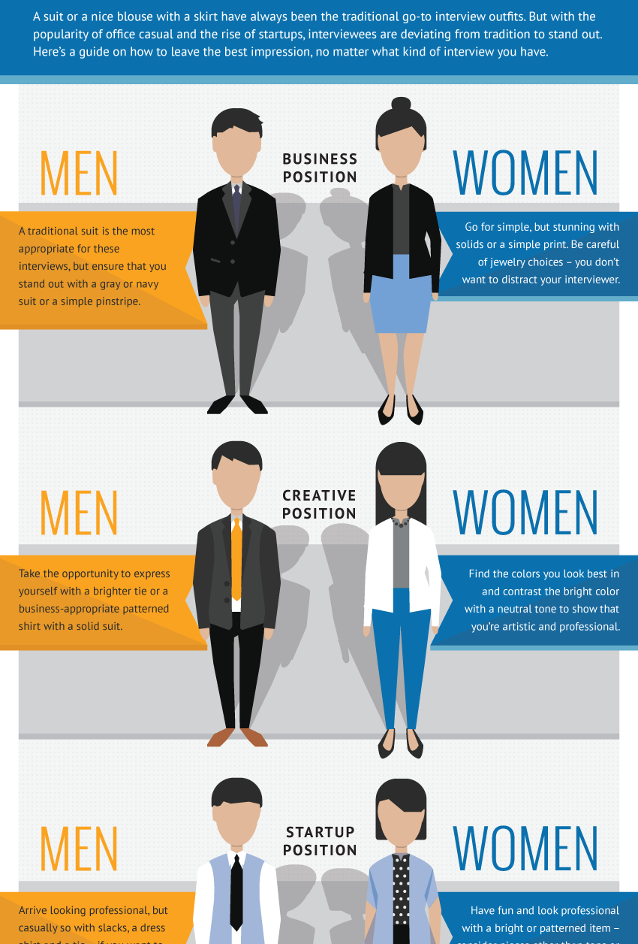
Dress to Impress
Notes:
Dress formally and well groomed
You will never get a second chance to make a good impression
Wear something that make you feel comfortable
Use simple accessories like simple jewellery, watches, ties etc
Scents, perfumes and other shave lotions should be avoided

Slide 19
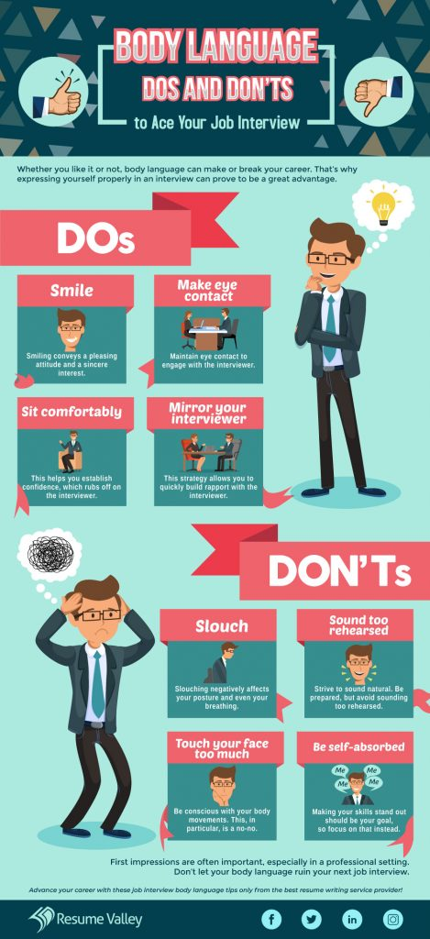
Notes:
It is a form of non-verbal communication, consisting of body pose, gestures, and eye movements. Humans send & interpret such signals sub consciously
It may provide clues as to the attitude or state of mind of a person. For ex, it may indicate aggression, attentiveness, boredom, relaxed state, amusement, pleasure etc
Good Eye Contact, Smile
Open Body Language, Breathe deeply
Don’t slouch, Be engaged
Make sure your eyes sparkle

Slide 21

Panel Interview

Slide 22

Exit Interview

Slide 23

Stress Interview

Slide 24
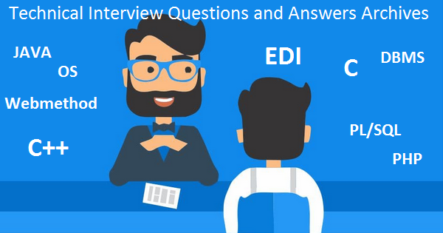
Technical Interview

Slide 25
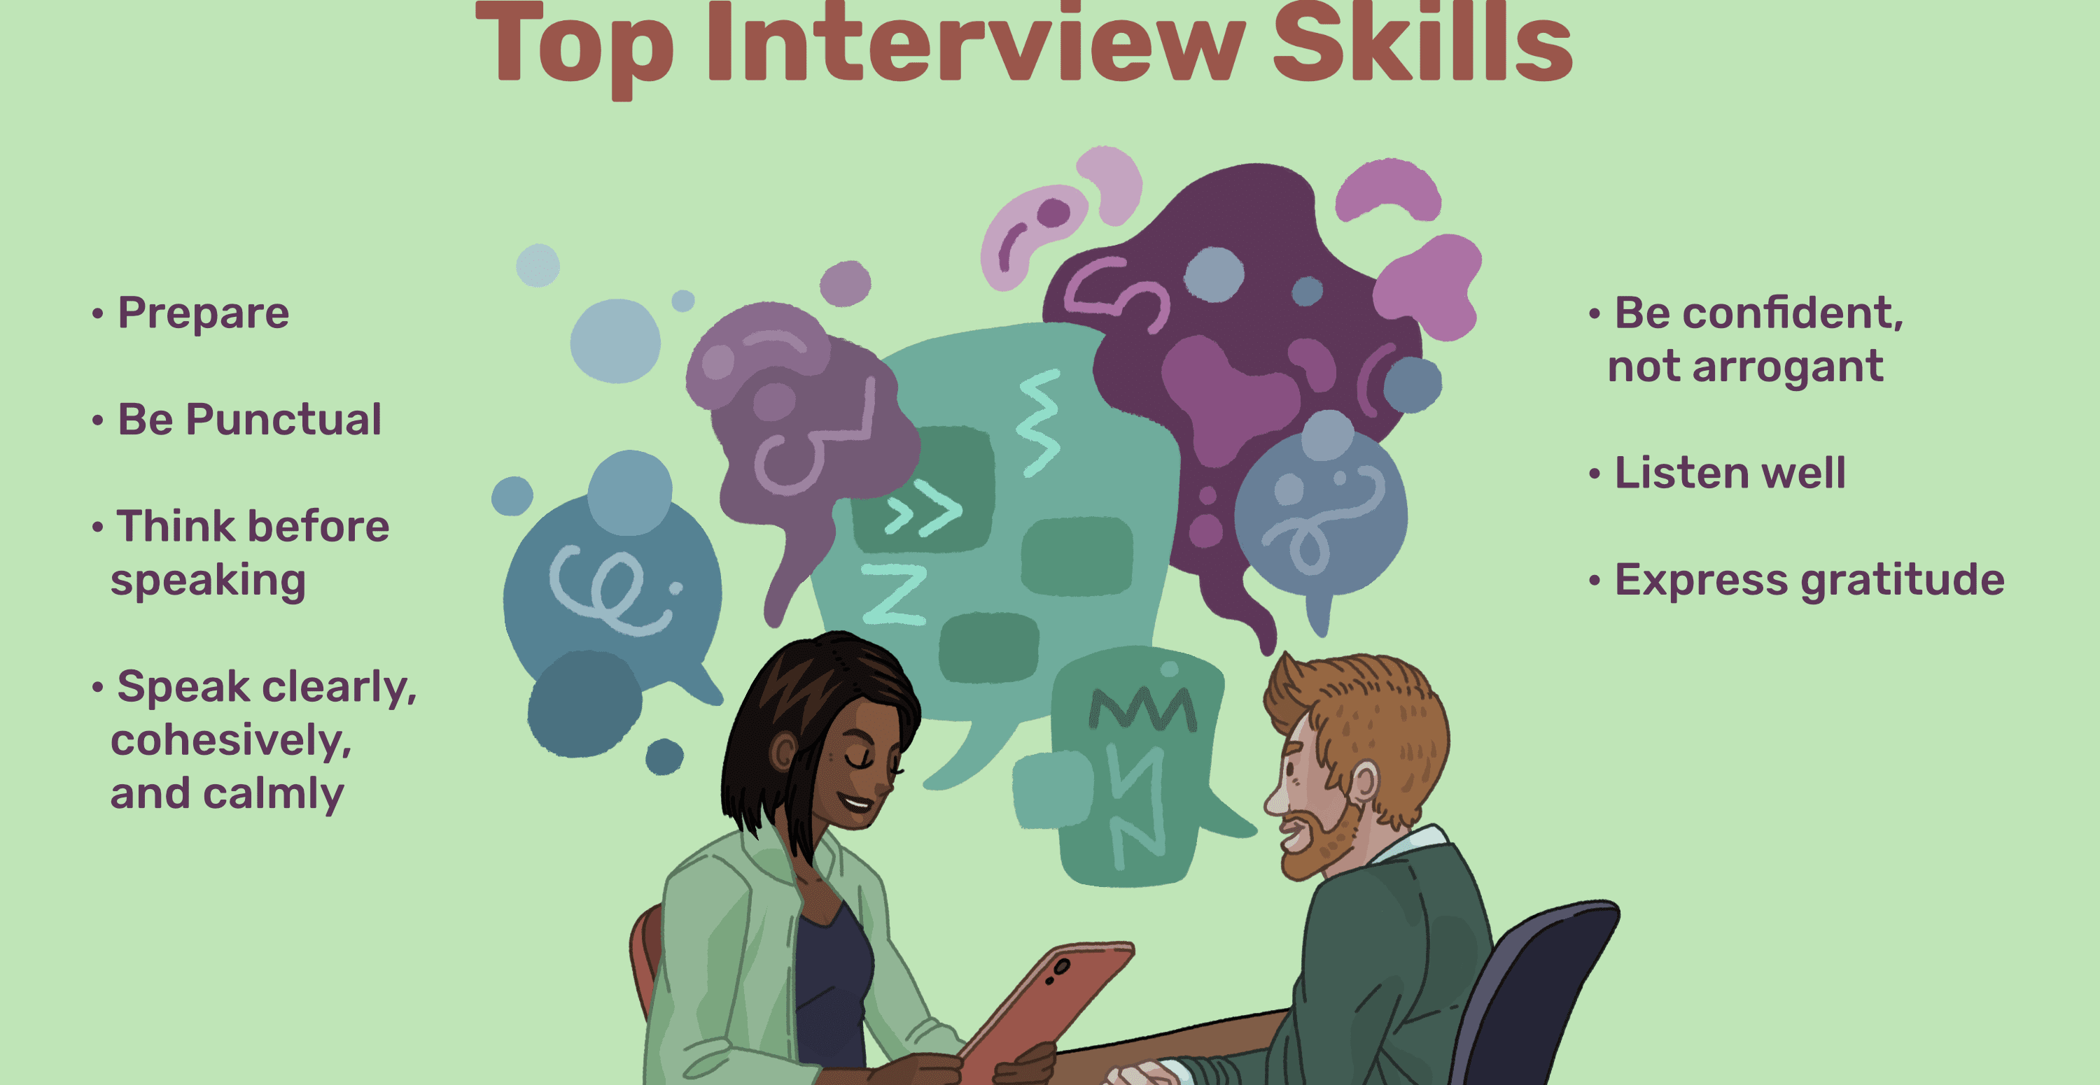
Notes:
Do take a practice run to the location where you are having the interview
If presented with a job application, do fill it out neatly, completely & accurately
Do bring extra resumes to the interview
Do greet the interviewer & do shake hands firmly
Do wait until you are offered a chair before sitting
Do make good eye contact with your interviewer
Do show your enthusiasm in the position and the company
Do stress your achievements

Slide 26

Do Your Homework
Notes:
Main production/service
Annual sales, profit, dividend
Competitors
Area of operation
New product/ service launchedBe prepared!
Know the company
Read your CV/application and skills demanded
Go to the company web site
Annual reports
Business news papers, magazines
Directly contact the employees

Slide 27

Additional tips
Focus on presenting a positive, enthusiastic tone.
If you are asked to describe a weakness, mention lessons learned, and steer away from negative descriptions.
Think about three or four key points that you want to make about your personal characteristics, skills you have learned, and relevant experiences that demonstrate that you could perform the job well.
Find specific, rather than general, examples from your experience that illustrate important points about yourself.
When answering questions, focus on experiences that demonstrate flexibility, adaptability, responsibility, progress, achievement, creativity, initiative, and leadership.
If the employer signals the end of the interview and asks you for questions, and you haven't discussed some key points, say: "There are a couple of points I would like to mention.
Notes:
Don’t inquire about salary, vacations, bonuses, retirement, or other benefits until after you have received an offer.
Don’t bring up or discuss personal issues or family problems
Don’t say your past history, hence it is available in the CV itself

Slide 28
Some Interview Questions
Case Questions
Behavioral or situational questions
Role-play questions
Industry-specific questions
Brainteasers

Slide 29

General questions
• Tell me about yourself.
• What are your key experiences and accomplishments?
• How would you rank your achievements?
• What are your strengths and weaknesses?
• How would your friends describe you?
• What are the most important things to you in a job?
• What do you value in a supervisor?
• How would you describe your management style?
• What appeals to you about this job and organization?
• Describe the ideal position in our company.
• Why are you qualified for this position?

Slide 30
Examples:
I am XYZ (Name) I am a qualified Chartered Accountant having around 6 years of post-qualification experience I have also done the Diploma in IFRS from ACCA, UK I have spent last 5 years in developing my skills in R2R with mnc’s where I was appreciated for my team management skills & work I have gone through with the job description & it is quite similar with my previous roles & responsibilities. So, I would like to tell you about my roles in previous organisation, I was part of … team wherein I was taking care of….
Tell me about yourself

Slide 31
Most effective & acceptable reasons for leaving your job are positive – not negative
Desire to learn Desire to take on more responsibility Desire to relocate Desire for a career change Desire to gain a new skill or grow a current skill Company reorganization has led to change in job content Desire to improve work life balance Desire for a shorter commute to work
Why did you leave your last job?

Slide 32
What do you think you do good at this job?
Example:
The best is to say general & say something like: A job where I love to work, like the people, can contribute more to the company A job which is challenging, a job which gives me opportunities to prove knowledge & skills

Slide 33
Example:
You must go to the website and look for the details like company, products, services, year of starting the company, their annual reports, agenda etc How many employees are working in that company, founder/CEO of the company, any recent mergers happened in last year etc
What do you know about this company?

Slide 34

The Phone Interview
Due to a company's geographic location, travel costs, and divergent schedules, a phone interview may often be your initial contact with a prospective employer. Therefore, we're offering some phone interview tips.
Objective - The idea behind a phone interview is to gain an invitation for a personal interview, and to gather more information for future steps in the process.
Preparation - Have a pad, pen, and a copy of your resume near the phone. Use a phone in a quiet area. Avoid any background noise. Also avoid using a cordless phone, because they tend to transmit poorly.

Slide 35
Speaking
Smile and be enthusiastic. Your enthusiasm will carry through to the interviewer.
Speak in a conversational manner and be sure to speak loudly enough to be heard. Speak with some inflection and tone.
Let the interviewer do most of the talking. When s/he asks you a question, expound upon the answer. Use the opportunity to sell your skills and experience.
When the interview is over, let her/him know that you are very interested in scheduling a personal interview at her/his place of business.

Slide 36
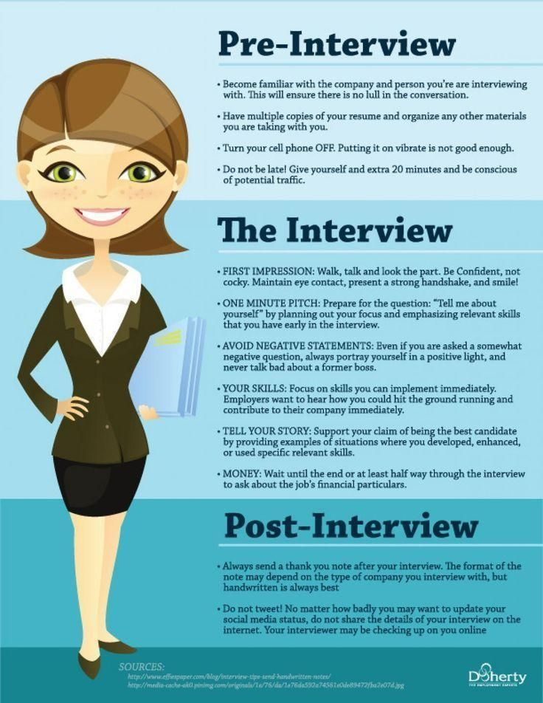

Slide 37
Self Evaluation
How your present and experience relate to the position?
Your current and future career goals
What skills and expertise you have to offer
The skills that you would like to develop or improve
Location, salary, and lifestyle priorities
Kinds of people and environments you prefer

Slide 40
Interview tips

Slide 41
Top Picks from the Interviewer
First impressions
Answering to questions
How you speak
Your personal appearance
Your eye contact
How well you have prepared
How confident you are about the Job

Slide 42
Few Etiquettes
At the beginning of the Interview – GREET
At the end of the interview – THANK
LISTEN before answering
Know when to stop answering
Focus on your accomplishments – Unique Selling Points (What makes you stand out from other candidates)
Stay cool

Slide 43
Few sample Questions
Tell me about yourself?
What experience you have that is related to this job?
What skills do you have that make you a suitable candidate?
What problems have you encountered in past jobs or other areas of life and how did you overcome them?
Tell me about a situation when you have contributed to a team’s success?
How do you see yourself progressing in the next five years?
Do you have any Questions for Us?
Notes:
Trainer’s speak :-

Slide 44
Tell me about yourself ?
How to answer well :
My Name is …… I Completed my Grad./ PG from ….., having around 6 years of experience I have also done the special course on ……… During my experience I have developed skills in R2R and….where I was appreciated for my performance and outcomes I have gone through with the Job description & it is almost similar with my previous role So I would like to tell you about my role in previous organisation, I was part of … team wherein I was taking care of….

Slide 45
Few Qs you may ask the interviewer
Which Team that I am going to work with?
Who will I be directly Reporting to?
What Kind of Responsibilities My Role require?
What further training or learning opportunities are available?
What are the opportunities for career progression?
What is the shift to work and location?
May I know about the next steps in the interview process?

Slide 46
Behavioral Interview Qs
Describe a situation when you were faced with a stressful situation that demonstrated your coping skills?
Describe a situation when you were able to have a positive influence on the actions of others?
What have you done in the past to contribute towards team success?
Tell me what would you do where you dis-agree with your Manager on Process front?

Slide 47
STAR Technique
S - Situation
Situation – describe the situation that you were in
Task – describe the task that you needed to accomplish
Action – describe the action you took
Results – What did you accomplish or learn?
R - Result
T - Task
A - Action

Slide 48
What’s the Interviewer looking for..?
Can you do the job and how well?
How well will you get along with your team ?
Do you have the skills needed to be productive and make a positive contribution quickly?
Have you done this job elsewhere and, if so, how successful were you?
If you haven’t done this job, do you have the potential to be successful in the role?
Will you stay long enough with the Role to make significant contributions?
Thought Process Communication Solutions

Slide 49


4 Ps for Success
Plan
Prepare
Practice
Perform

Slide 50

What Employers Want and Expect From College Graduates & What Students Want From Employers

Slide 51

93 percent of employers said that a demonstrated capacity to think critically, communicate clearly and solve complex problems is more important than any other attributes the student can offer.
They say they prioritize hiring college graduates with skills that will help them contribute to innovation in the workplace.

Slide 52
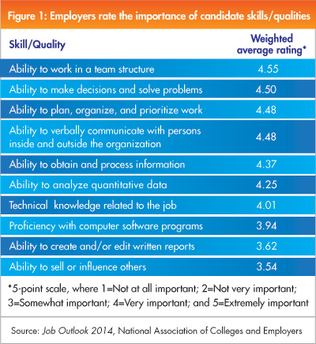
Skills Employers Want

Slide 53
1. They need to have realistic goals and expectations.
2. They need to be true team players and have a can-do positive attitude
3. Not be afraid of a four letter word - W.O.R.K.- hard work will get you rewarded and promoted! Seek internships if there are opportunities in their field.
4. They should seek Mentors and enjoy networking whenever possible.
5. Take on leadership opportunities whenever possible (i.e. clubs, sports, work, etc.)
Expectations

Slide 54
Trinity Logistics - Denise Crockett(Talent Acquisition Manager)
Denise’s view on what they expect,
1. We look to ensure students are involved in organizations, sports, volunteering, part time jobs. Shows they can multi-task!
2. Personality – they need to bring it to the table. In our organization we only have a service to sell, so if they come to the interview lacking personality (ambition and drive to do the job) we will continue to look at the next candidate.
3. Showing up to the interview in appropriate attire. Having one or two outfits set aside just for the interview process.
4. Knowing our company. Who we are and what we do. I see many students who do their homework and research our company, however for every one student that does this one student does not. When a student has not researched our company and can’t tell me what we do, I think of it as them just looking for a job and not a career. They didn’t take the time.

Slide 55

What you need to look into when you consider a job
Nature of the work
Compensation
Co-workers
Opportunity for personal growth
Job security
Friendly co-workers
Annual salary increases

Slide 56
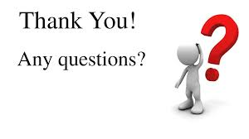

Slide 57


Slide 58
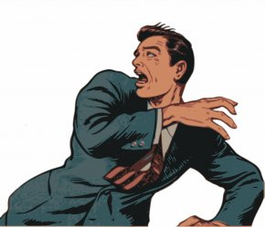



By the end of the session:​
You will be able to approach interviews more confidently and may even start to look forward to them!​​
What concerns do you have about interviews?
Fear
Nervousness
Lack of Confidence
Lack of Knowledge, etc​​

